Slide 1


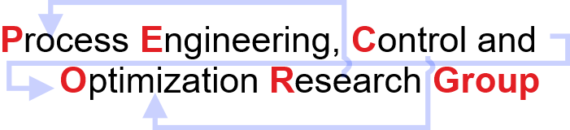
CL-699 Mid-Semester Presentation
Bilevel Programming And It’s Application to
Model Predictive Control
Subhi Gupta
Discipline of Chemical Engineering,
Indian Institute of Technology Gandhinagar,
Palaj, Gujarat – 382055
India

Slide 2
Content
Bilevel Programming problems (BLPP)
Parametric and Multiparametric programming
Bilevel Model Predictive Control (BMPC)
System Modeling and Identification
Model Predictive Control (MPC) on TCLab
Data Driven State Space Equations
Explicit MPC (mp-MPC) on TCLab
BMPC on TCLab
Austenitization Furnace

Slide 3
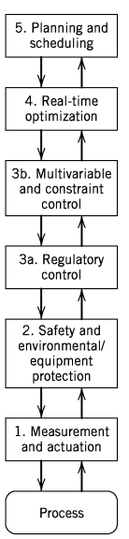
Hierarchical order in process industry
Multilevel Decision Making Structures
Background
Optimization/Profit
(Fourth Layer)
Model predictive control (MPC) strategy.
Main Objectives
Quality
(Third Layer)
Standard feedback and feedforward control techniques.
Safety
(Second layer)
Alarm Management , Emergency Shutdown.
The objective of such structures:
Division of tasks into subtasks.
To measure process variables and implement the calculated control actions.
The functional multilayer process control hierarchy (Adapted from Seborg et al. 2016)
.Seborg, D. E., Edgar, T. F., Mellichamp, D. A., & Doyle III, F. J. (2016).

Slide 4
Bilevel Programming Problem (BLPP)
Bilevel Decision Making Structures
Motivation
Bilevel programming has evolved significantly in recent years.
In some literature, researchers have addressed bilevel decision-making problems.
Ryu et al. have taken one level as plant planning/control problem and other level as as distribution network problem.
Avraamidou et al. have recasted planning and scheduling integration as a bi-level multi-follower problem. Upper level (planning) and lower level (scheduling).
Tri-level and other general multi-level programming problems too are evolving gradually.
Upper-level subsystem
(Optimization Problem 1)
Decision
connections
Information
connections
Lower-level subsystem
(Optimization Problem 2)
Structure of a BLPP
Understanding natural hierarchy in optimization problems is crucial for solving problems efficiently.
Computers & Chemical Engineering 28.6-7 (2004): 1121-1129.
2018 European Control Conference (ECC). IEEE, 2018.

Slide 5


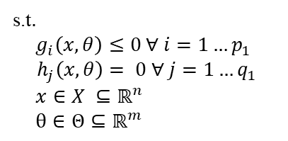
Parametric Programming
An Effective Solution Strategy
Takes into account varying parameters (𝜃).
Approach is to obtain the optimal solution (𝒙) as an explicit function of the parameters.
General parametric nonlinear programming problem
To solve such programming problems
POP toolbox was used in our work.
https://parametric.tamu.edu/POP/

Slide 6
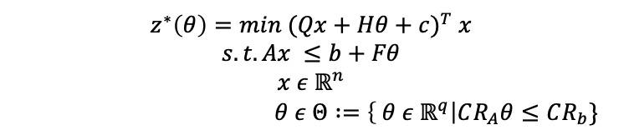
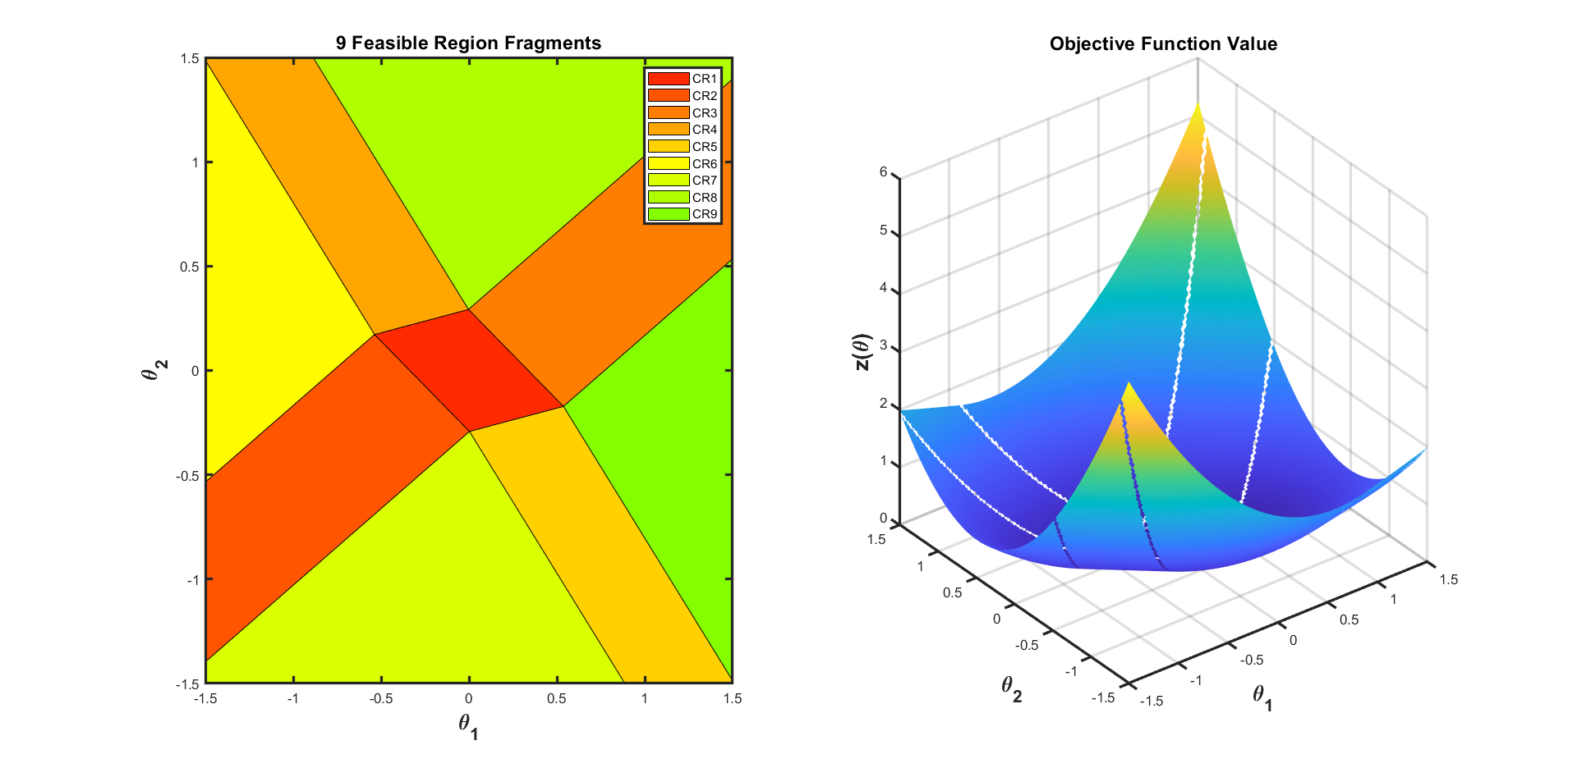
Multiparametric Programming
Formulation of Multiparametric Linear (mp-LP) and Quadratic Programming (mp-QP)
Solution of mp-QP: 𝒙(𝜃)^{𝘪}=𝑊^{𝘪}𝜃 + 𝘸 CR^{𝘪}: Φ^{𝘪}𝜃≤𝜙^{𝘪}
The parameter space(𝜃 ) is characterised into
nine set of critical regions (CR_{i}).
Each critical region has its own function optimal solution x*(𝜃 ) and Z*(𝜃 )
Journal of Global Optimization 38.4 (2007): 609.

Slide 7







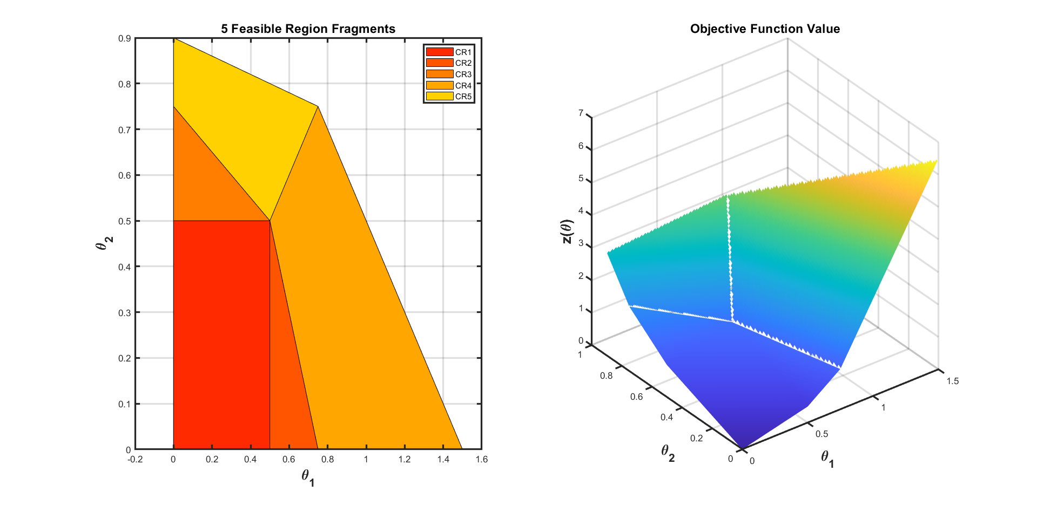
Bilevel Programming Problem (BLPP)
Formulation of Linear BLPP (LP/BLPP)
Five critical regions are obtained with y as an explicit function of x.
y=f(x)
Inner Level solved multi-parametrically
Reference: Faísca, Nuno P., et al. Journal of Global Optimization 38.4 (2007).

Slide 8
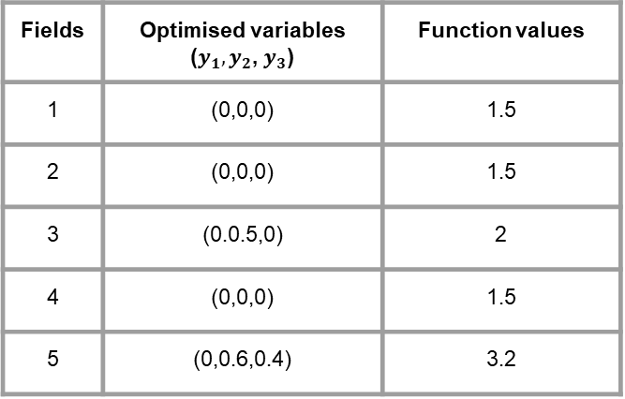
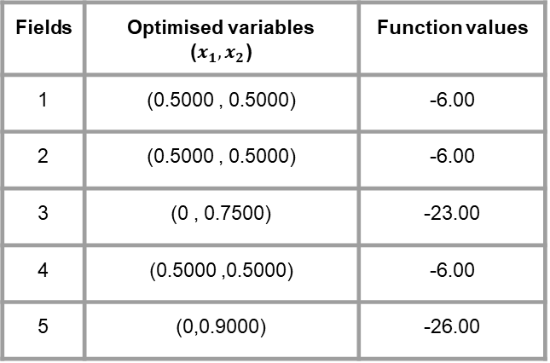
Bilevel Programming Problem (BLPP)
Solution of a linear bilevel programming problem.
The solution obtained after solving five LP outer level problem
Fields | Optimised variables ($x_{1},x_{2}$) | Function values
1 | (0.5000 , 0.5000) | -6.00
2 | (0.5000 , 0.5000) | -6.00
3 | (0 , 0.7500) | -23.00
4 | (0.5000 ,0.5000) | -6.00
5 | (0,0.9000) | -26.00
Substitution of optimized variables to get solutions to inner-level problems.
Fields | Optimised variables ($y_{1},y_{2}$,$y_{3}$) | Function values
1 | (0,0,0) | 1.5
2 | (0,0,0) | 1.5
3 | (0.0.5,0) | 2
4 | (0,0,0) | 1.5
5 | (0,0.6,0.4) | 3.2
Global optimum solution

Slide 9
Bilevel Model predictive control
One of the applications of Bilevel lies in Hierarchical Model Predictive Control (MPC) structures.
A recent attempt has been made to solve MPC in a hierarchical manner.
Avraamidou et al. (2017) employed two-level hierarchical mp-MPC on a continuous stirred tank reactor (CSTR) system.
Multi-parametric bi-level algorithms for the development of explicit hierarchical controllers have been less explored.
So such algorithms hold a good possibility to be explored and extended on more complex systems in near future.
Controller 1 (Optimisation Problem 1)
Controller 2 (Optimisation Problem 2)
System
Computer aided chemical engineering. Vol. 40. Elsevier, 2017. 1591-1596.

Slide 10
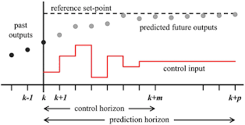
Model Predictive Control
Introduction
MPC Controller
(Objective Function + Model + Constraints)
Reference
Plant
State Estimator
MPC solves an optimization problem at each k^{th} time step
Formulation
Quadratic Programming (QP) Problem
Image Source link: Wikipedia

Slide 11

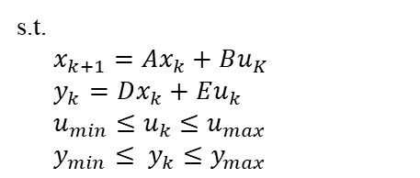
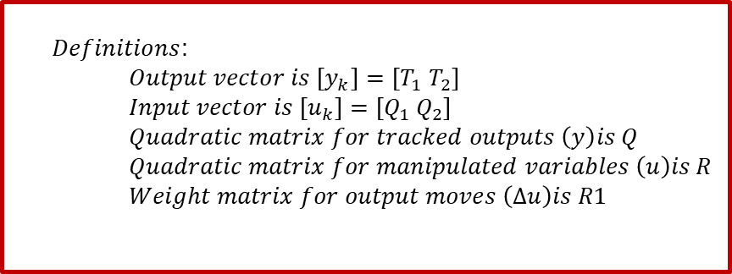
Linear Model Predictive Control on TCLab
Formulation
Objective function
$$\min{Σ {\left(y_{k}− y_{k}^{R}\right)}^{T} Q_{k}\left(y_{k}− y_{k}^{R}\right)+Σ{\left(u_{k}−u_{k}^{R}\right)}^{T}R_{k}\left(u_{k}−u_{k}^{R}\right)+ ΣΔu_{k}^{T}{R1}_{k}(Δu_{k})}$$
System Model
Constraints
$Definitions$: $$Output vector is \left[y_{k}\right]=\left[T_{1}{ T}_{2}\right] \\ Input vector is \left[u_{k}\right]=\left[Q_{1}{ Q}_{2}\right] \\ Quadratic matrix for tracked outputs \left(y\right)is Q \\ Quadratic matrix for manipulated variables \left(u\right)is R \\ Weight matrix for output moves \left(Δu\right)is R1$$
At each sampling instant the quadratic problem was solved using cplexqp solver.

Slide 12
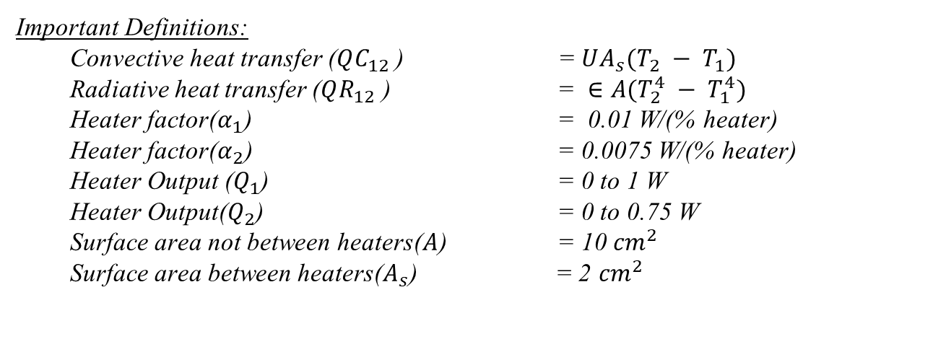



System Modeling and Identification
Dual Heater Modeling of TCLab (MIMO System)
Two energy balance equations that describe the dynamic temperature response
Convective Heat Transfer
Heater 1
$${(T}_{1})$$
Heater 2
$${(T}_{2})$$
Radiative Heat Transfer
$$T_{∞}$$
Reference link: apmonitor.com/do (John D. Hedengren)

Slide 13


Data-Driven State Space Equations
System Identification
The differential equations representing the physical system were first linearized around the steady-state point.
MATLAB System Identification Toolbox
(Data-Driven Toolbox)
The Step Response Analysis method was employed to obtain the data.
TCLab System captured using linear dynamics
The resulting pseudo states equations obtained in matrix form were used as linear constraints in MPC formulation.

Slide 14
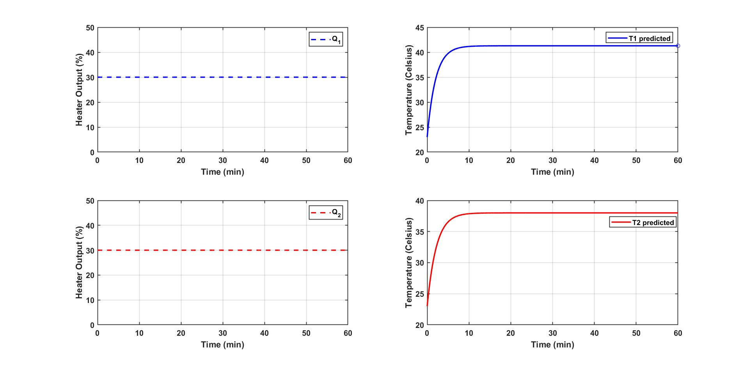
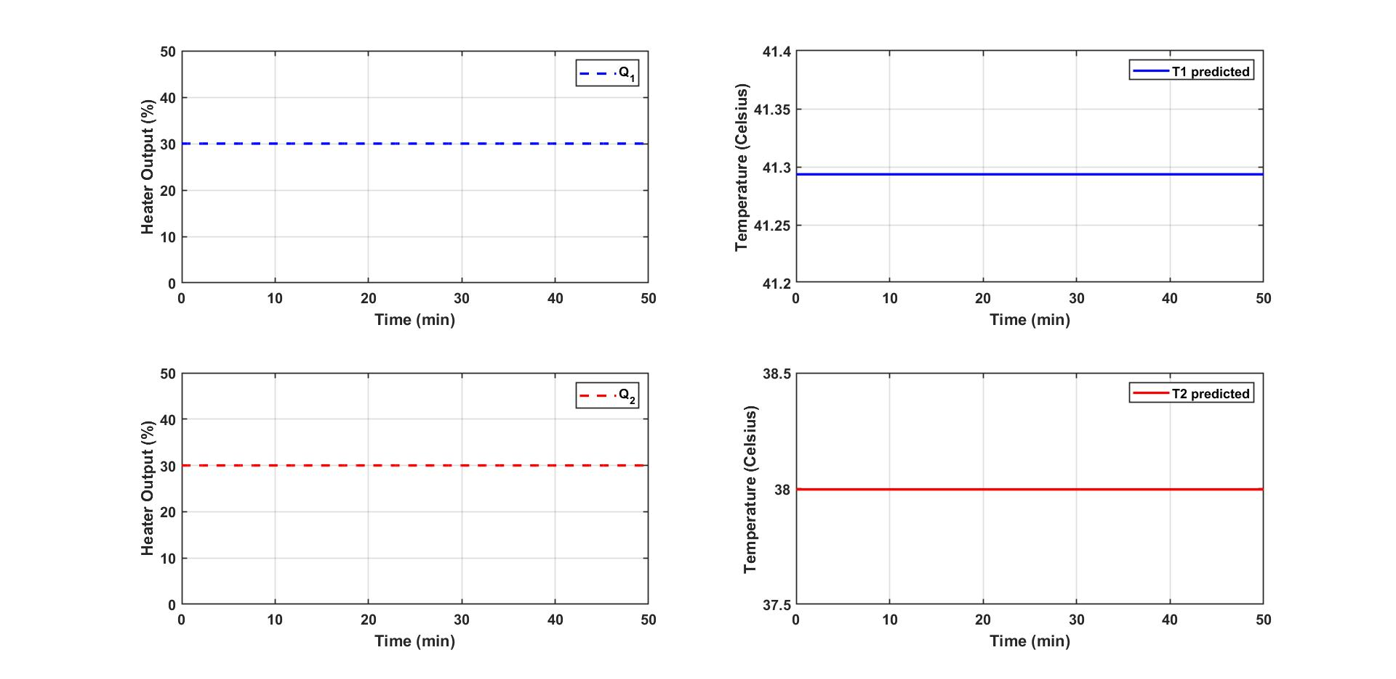
Data Driven State Space Equations
Steady State Response
Steady-state achieved for Q1=30 and Q2=30
Steady-state achieved for Q1=30 and Q2=30

Slide 15
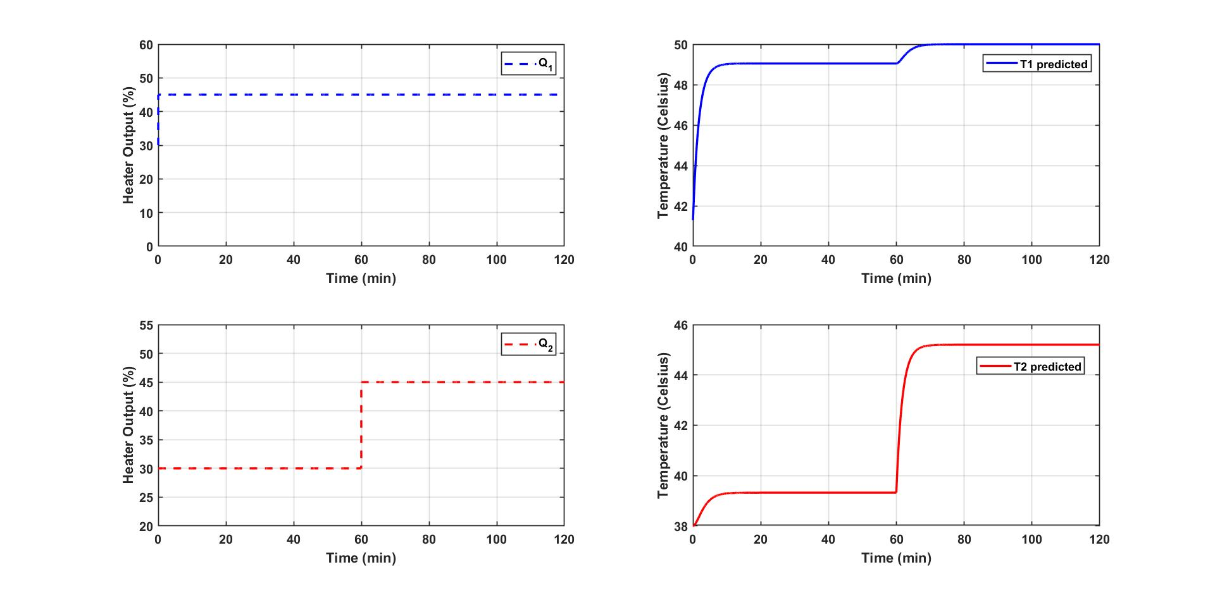
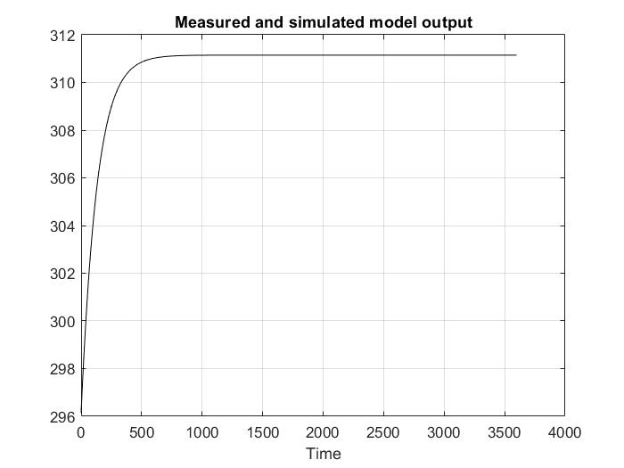
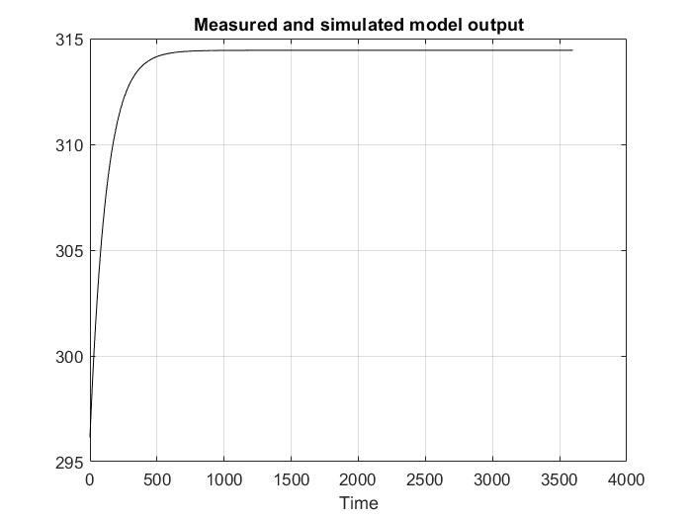

Data Driven State Space Equations
Step Response Analysis
Temperature simulation for step changes in Q1 and Q2
Number of states identified=4
$$y_{1}$$
$$y_{2}$$
.

Slide 16
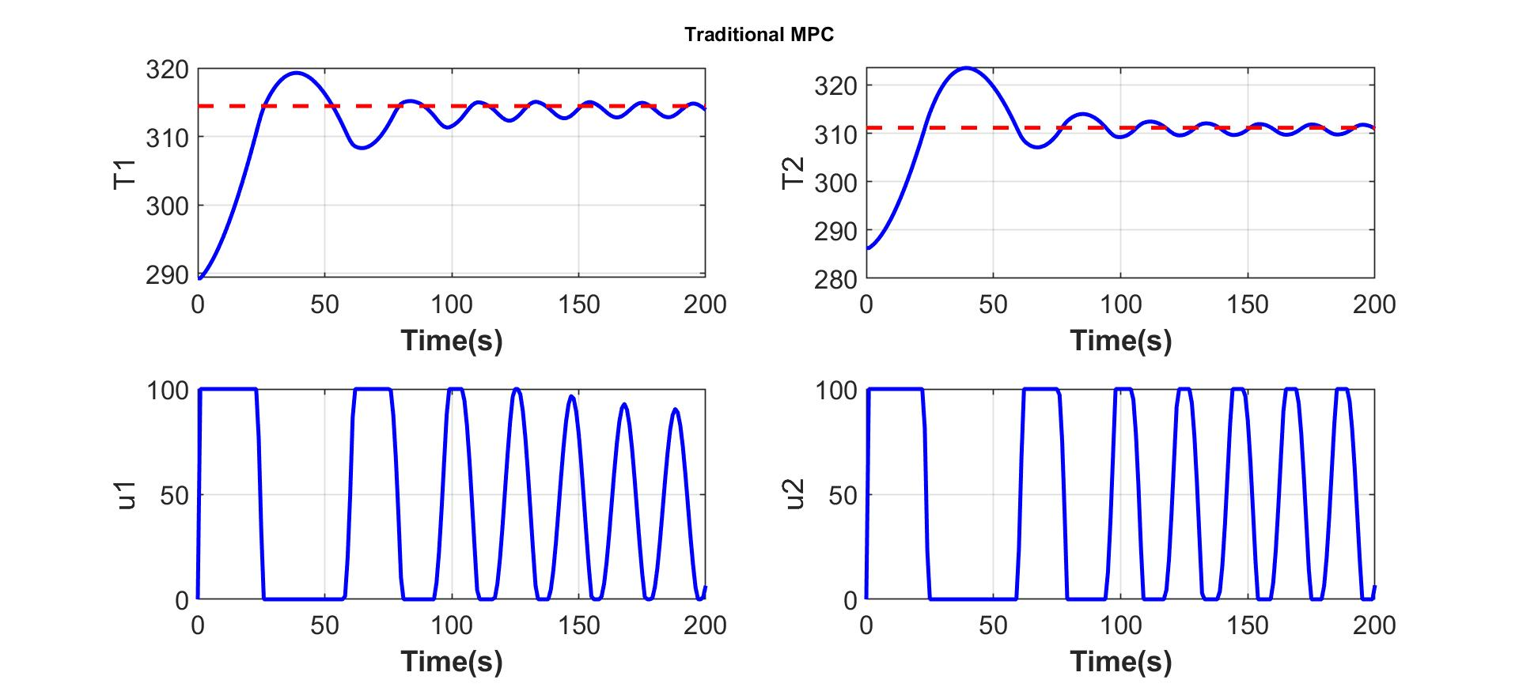
Closed-loop Simulation
Online MPC Control Calculations
Online MPC
Solving Online MPC is computationally complex.
Explicit MPC can greatly simplify runtime operation.
MPC formulation was solved multi-parametrically (mp-MPC).

Slide 17
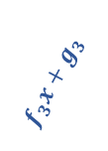
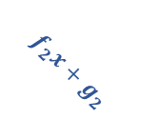
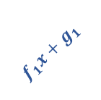

Explicit MPC
Advantages
Solves the optimization problem offline for all the states within a range.
Optimal solution is precomputed for each state within a range offline.
At each time step the region in which the current state lies is searched and then the linear function is evaluated to get the current control action.
u(x)
$$f_{1}x+g_{1 }$$
$$f_{3}x+g_{3 }$$
$$f_{1}x+g_{1 } 0<x<a$$
$$f_{2}x+g_{2}a≤x<b$$
$$f_{3}x+g_{3 }b≤x<c$$
$$f_{2}x+g_{2}$$
u(x)
a
b
c
x
Solution space is divided into several regions
Each region is mapped into unique optimal solution
Automatica 39.3 (2003): 489-497.

Slide 18

Closed Loop Simulation Results
Verification and Comparison
Online MPC
mp-MPC
Online MPC and mp-MPC results match.
No. | Type of MPC | Total runtime (s)
1 | Online MPC | 5.351
2 | mp-MPC | 0.912
Comparison based on runtime operation.
Runtime operation reduced by 83.52%.

Slide 19
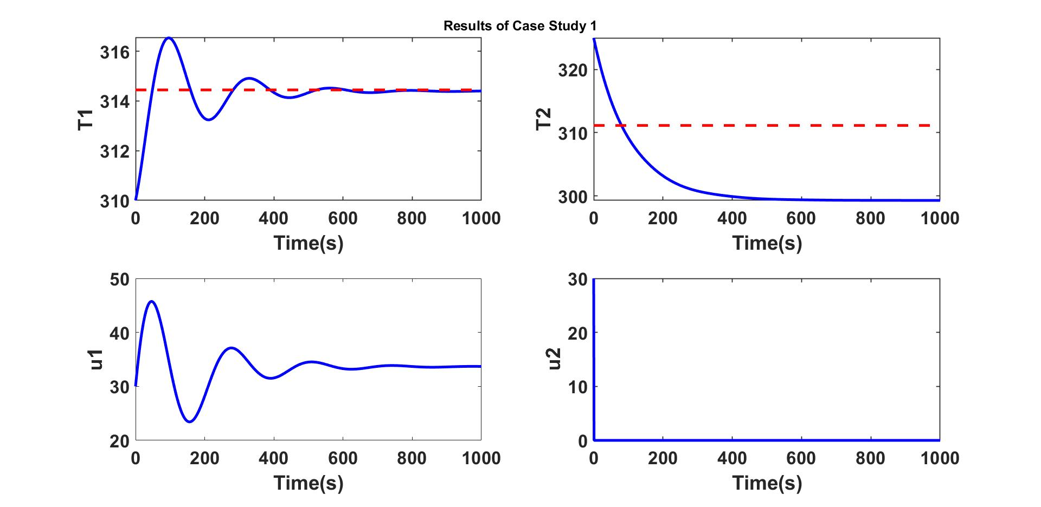
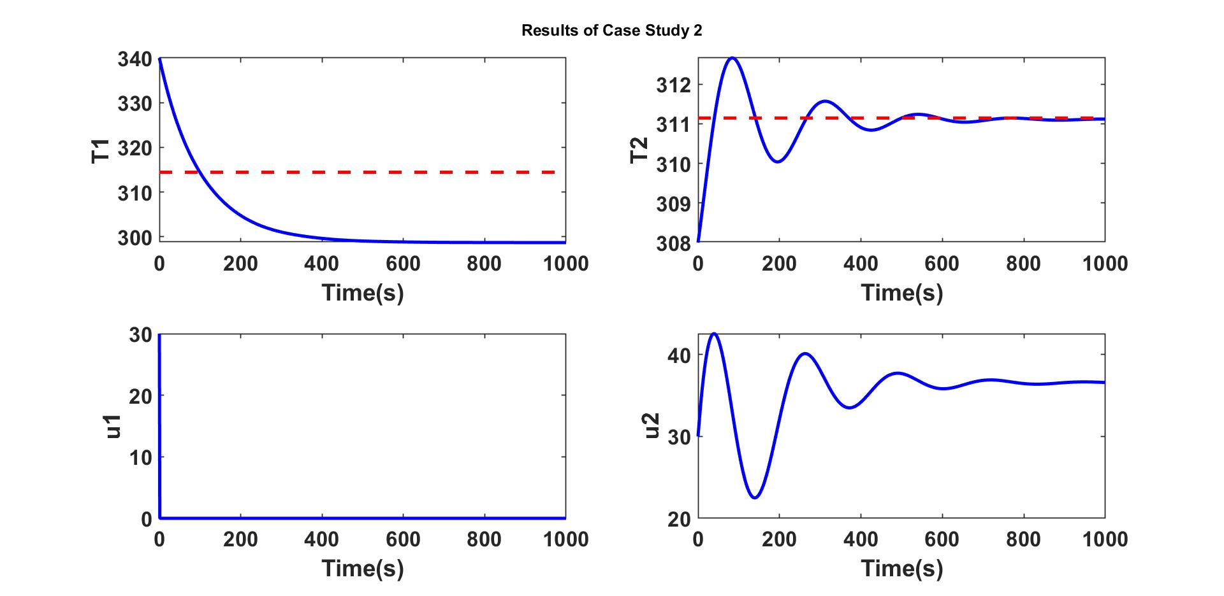

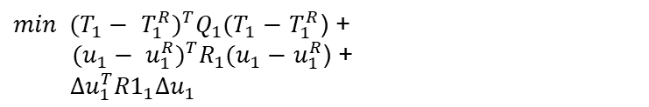


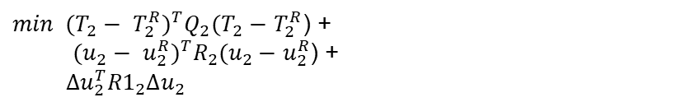


Bilevel Model predictive control (BMPC)
Explicit Hierarchical Controller on TCLab
$$\min{u_{1}+ u_{2}}$$
$$u_{2}$$
${min (T_{1}− T_{1}^{R})}^{T}Q_{1}(T_{1}−T_{1}^{R}$) +
${ (u_{1}− u_{1}^{R})}^{T}R_{1}(u_{1}−u_{1}^{R}$) +
$$Δu_{1}^{T}{R1}_{1}Δu_{1}$$
$$u_{1}$$
Case Study 1
$$\min{u_{1}+ u_{2}}$$
$$u_{1}$$
${min (T_{2}− T_{2}^{R})}^{T}Q_{2}(T_{2}−T_{2}^{R}$) +
${ (u_{2}− u_{2}^{R})}^{T}R_{2}(u_{2}−u_{2}^{R}$) +
$$Δu_{2}^{T}{R1}_{2}Δu_{2}$$
$$u_{2}$$
Case Study 2

Slide 20
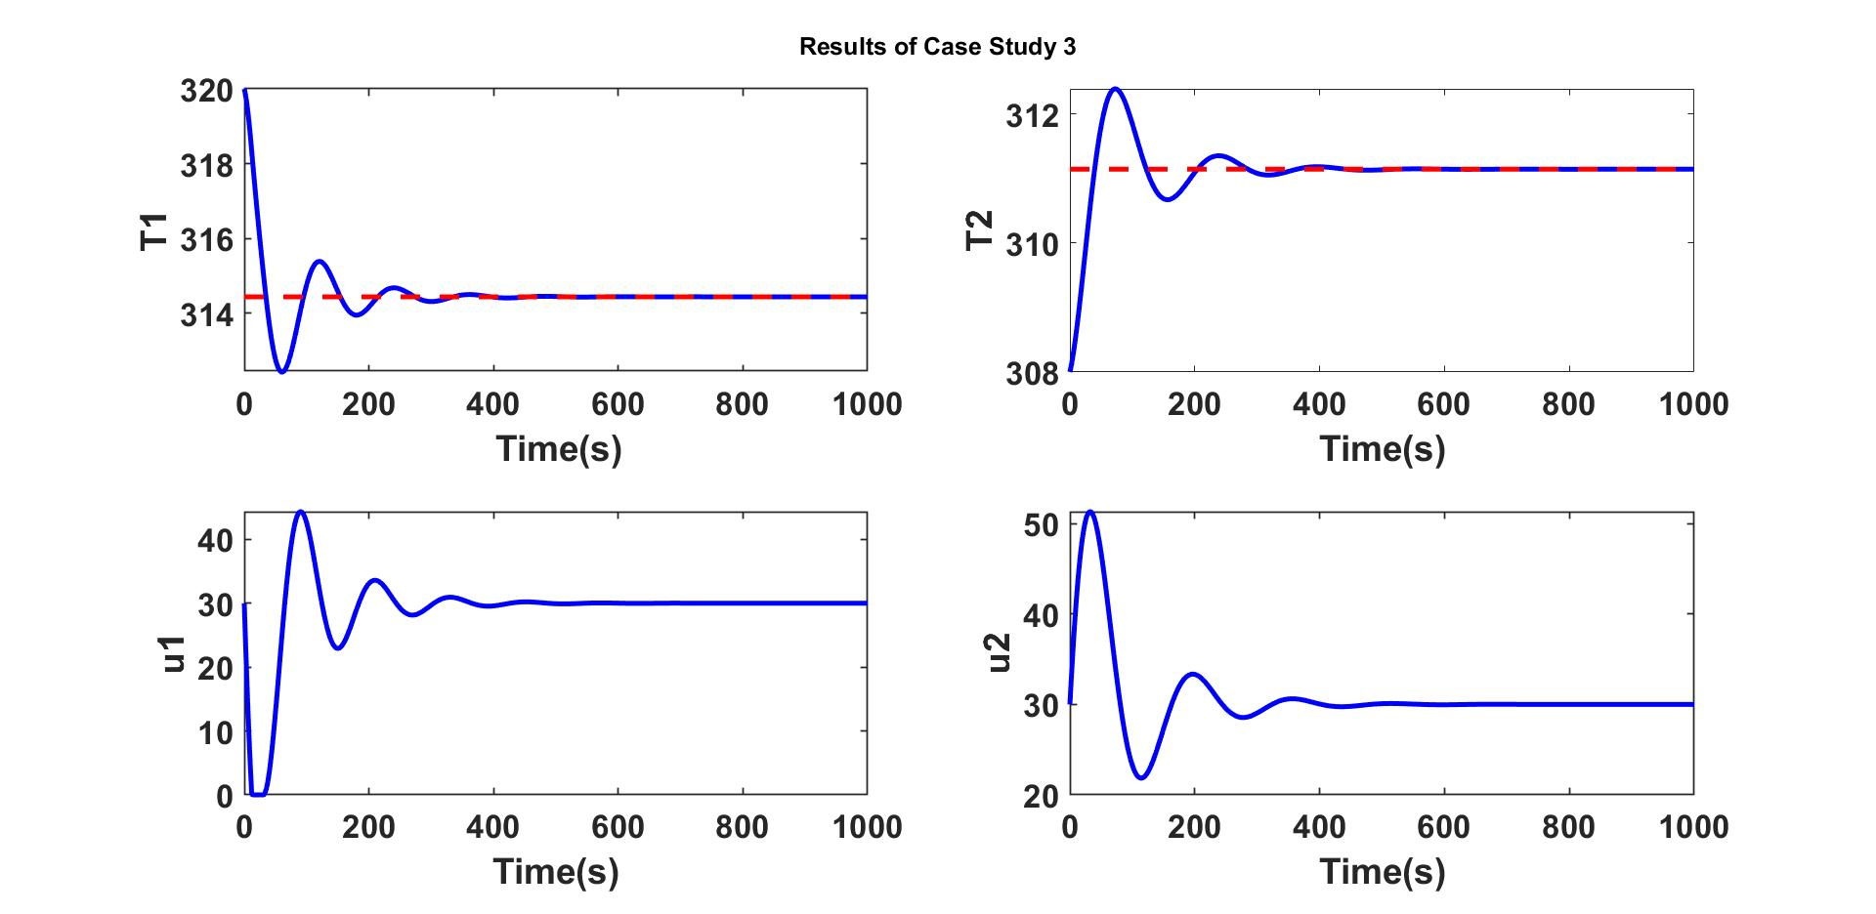
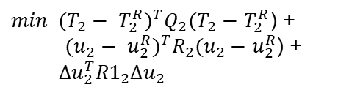

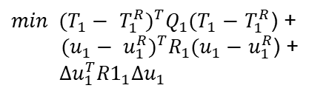
Bilevel Model predictive control (BMPC)
Explicit Hierarchical Controller on TCLab
${min (T_{1}− T_{1}^{R})}^{T}Q_{1}(T_{1}−T_{1}^{R}$) +
${ (u_{1}− u_{1}^{R})}^{T}R_{1}(u_{1}−u_{1}^{R}$) +
$$Δu_{1}^{T}{R1}_{1}Δu_{1}$$
$$u_{1}$$
${min (T_{2}− T_{2}^{R})}^{T}Q_{2}(T_{2}−T_{2}^{R}$) +
${ (u_{2}− u_{2}^{R})}^{T}R_{2}(u_{2}−u_{2}^{R}$) +
$$Δu_{2}^{T}{R1}_{2}Δu_{2}$$
$$u_{2}$$
Case Study 3
TCLab system is a simple MIMO device.
Explicit MPC and Hierarchical Controller algorithms were
easy to understand.

Slide 21
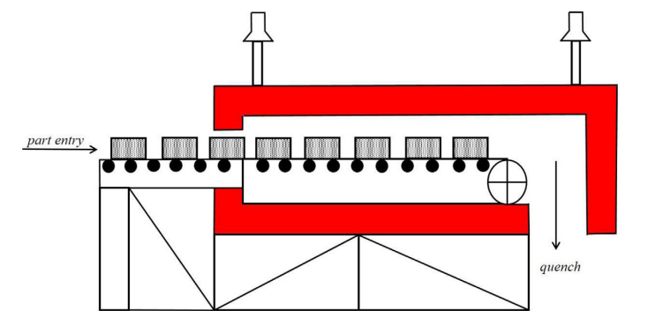
Austenitization Furnace
Introduction
Heng et al. (2017) addressed problems that can occur in a heat-treating furnace.
Ganesh et al. (2019) addressed problems that can occur during the austenitization process.
They aim to achieve two main objectives:
To ensure that the final product has the desired quality (target product toughness).
To minimize energy consumption during the austenitization process.
Two mathematical models developed by them:
Furnace model
Empirical austenite grain growth prediction model
Schematic of Heat Treating Furnace(Ganesh et al. (2019))
To determine the temperature profile of the parts in the furnace over time and position.
Predicting the average size of austenite grains which is influenced by the furnace's temperature profile.
Crucial in determining the toughness of the quenched product.
Journal of Dynamic Systems, Measurement, and Control 139.6 (2017): 061014.

Slide 22
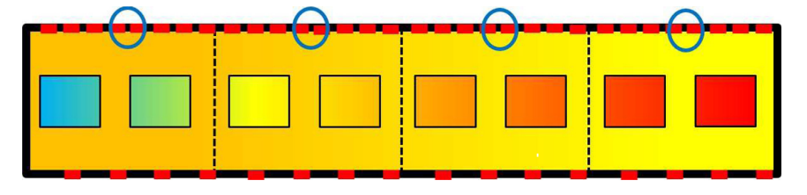
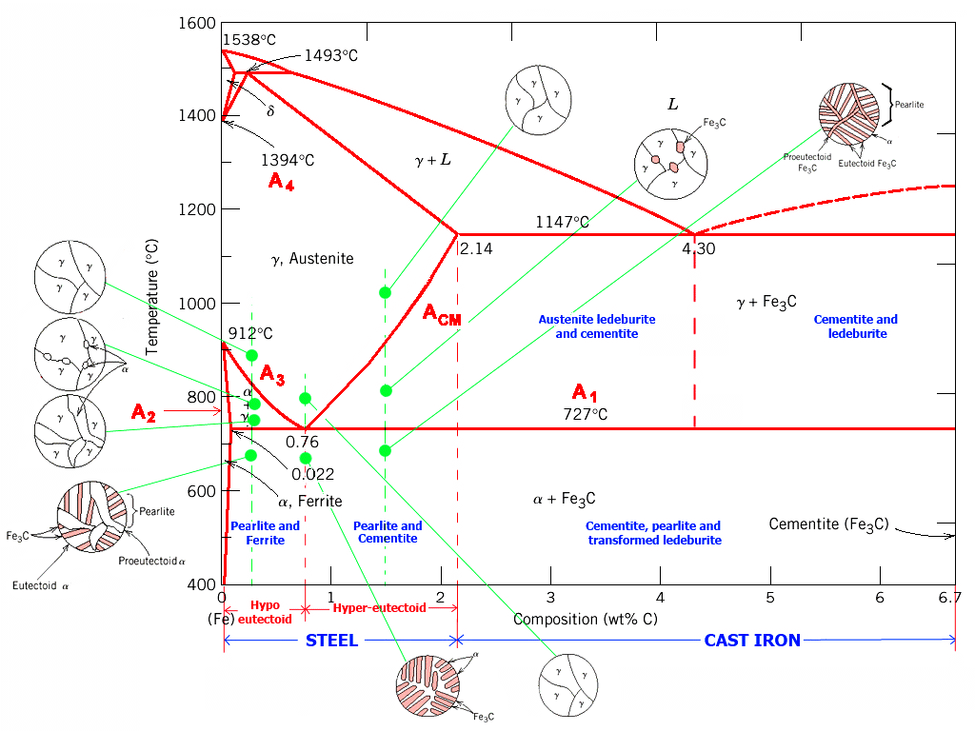
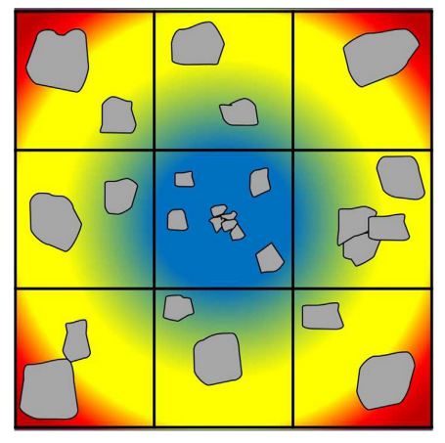
Austenitization Furnace
Schematic of the 2D Model of Austenitization Furnace (Ganesh et al. (2019))
Image Source link: Wikipedia
Part temperature and grain size distribution diagram
(Ganesh et al. (2019))

Slide 23
Austenitization Furnace
Model Predictive Control
To produce a sound product, controlling both macroscopic factors (temperature) and microscopic factors (austenite grain size) is essential.
Zone Temperatures
(Zone 3 and Zone 4)
Minimum Part Temperature
Maximum grain size
Temperature
Set Points
Model Predictive
Controller
Furnace
Controlled Inputs: Zone Temperature Set points
Controlled Outputs: Minimum Part Temperature, Maximum grain size
Selected major two zone temperatures which have
prominent effect on the output.

Slide 24
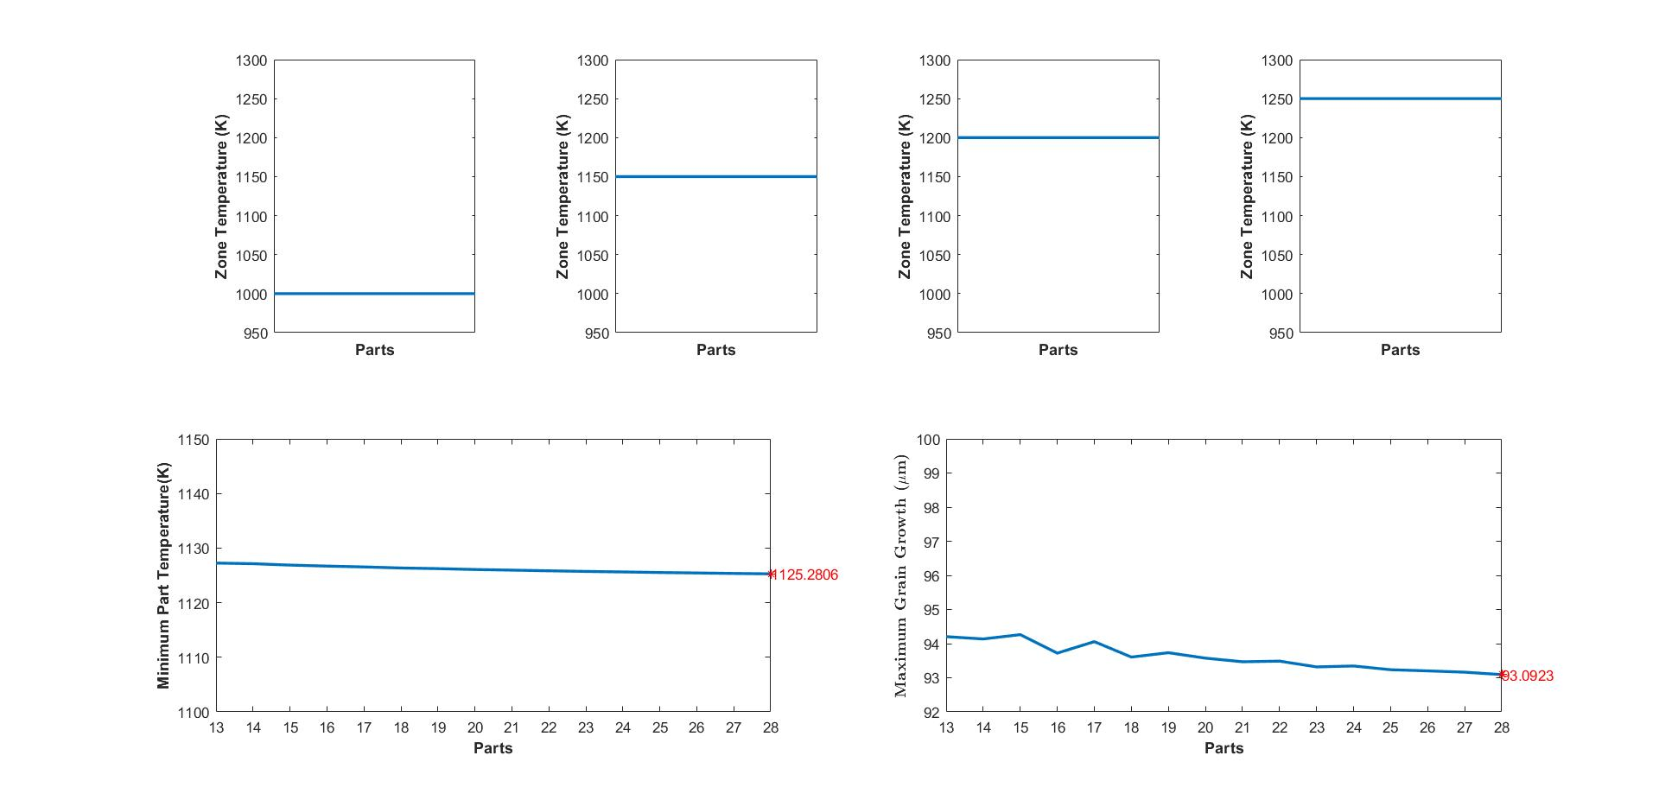
Austenitization Furnace
Simulation for Heuristic Zone Temperature Setpoints
Recorded Minimum Part temperature and
Maximum grain growth at the exit.
13-28 parts have been considered at steady state condition.

Slide 25
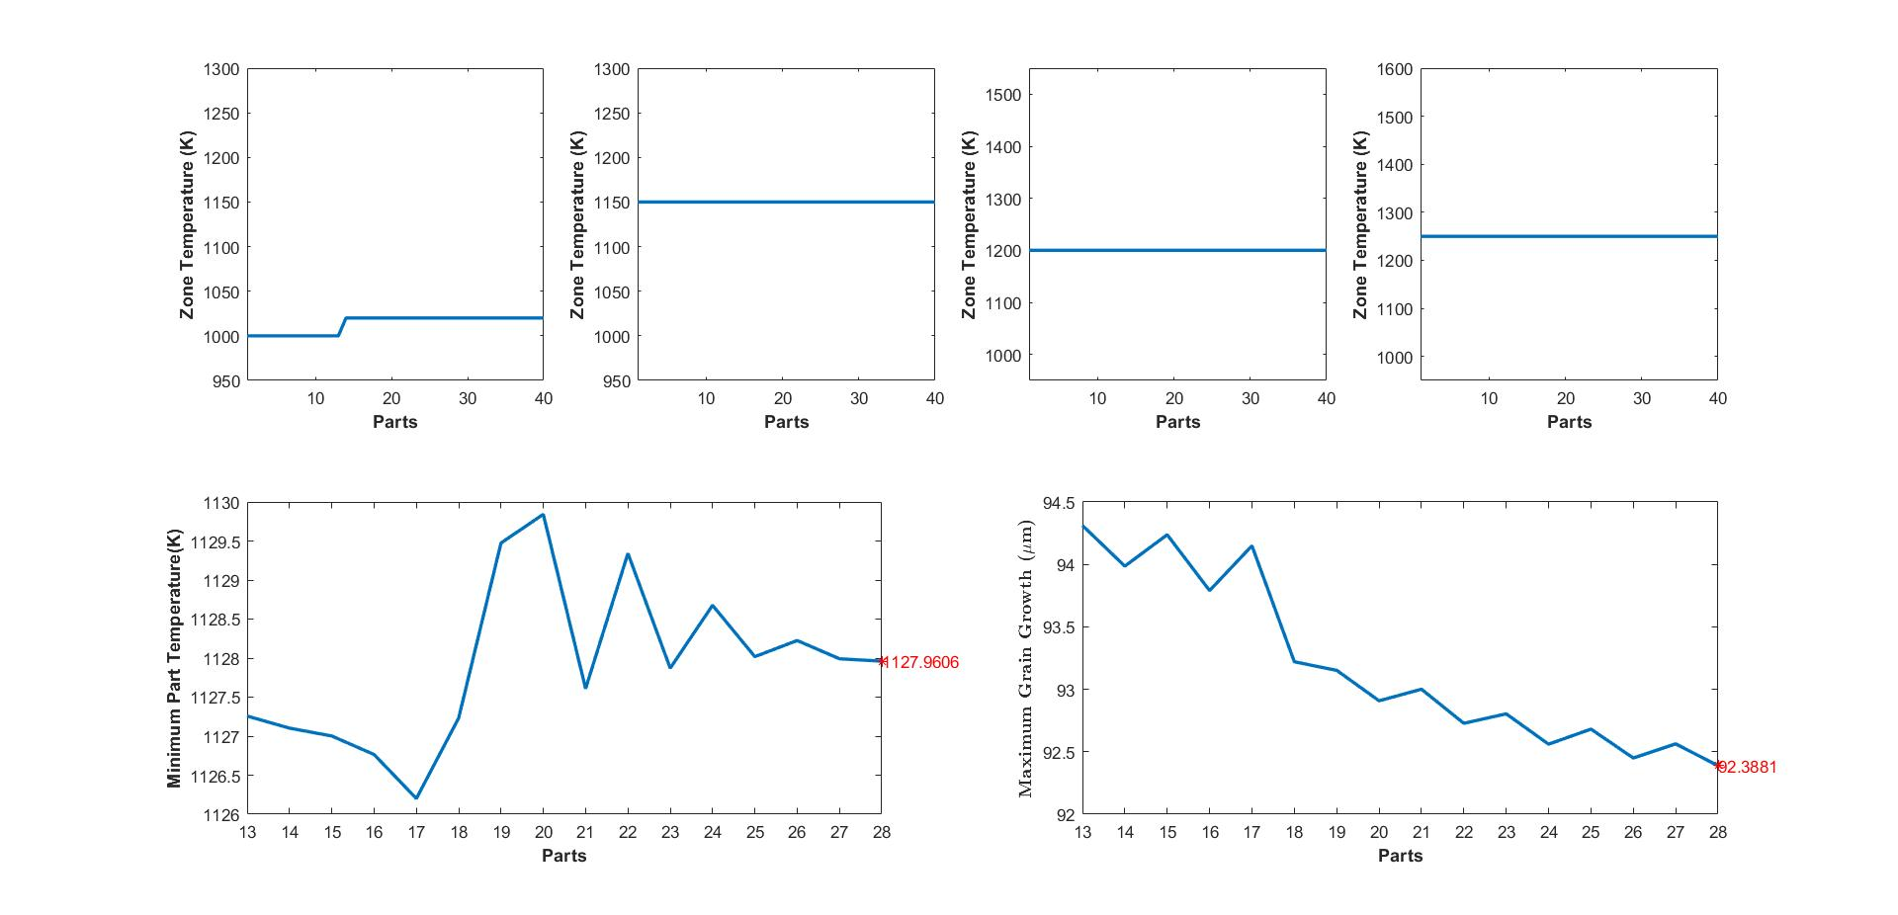
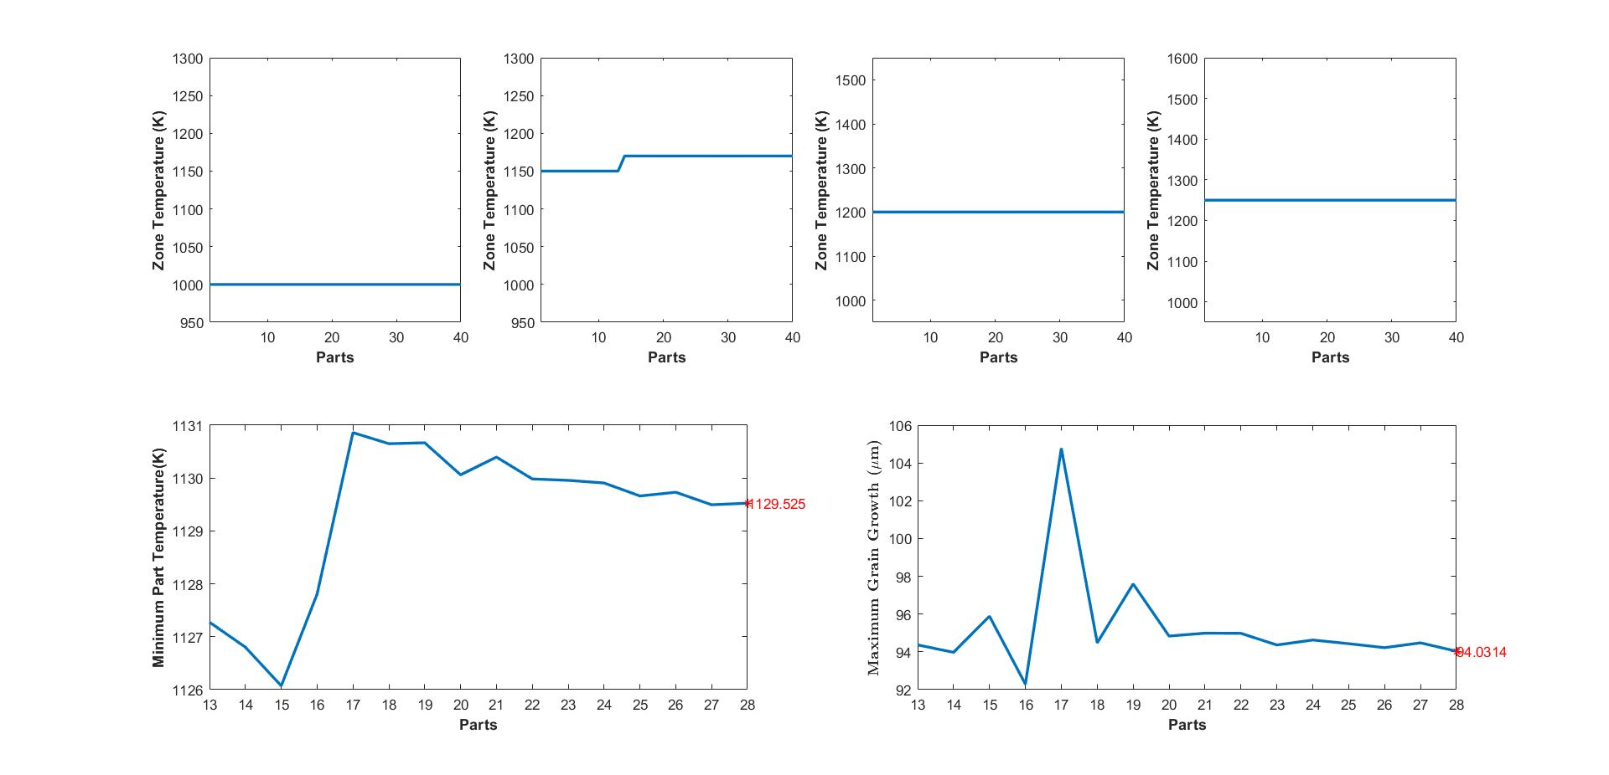
Step response Analysis
Austenitization Furnace
Given a step change of 20K in Zone 1 and Zone 2 temperatures.
Zone 1 changes:
Grain Size: 8.67% 0.75%
Min Part Temperature:0.24%
Zone 2 changes:
Grain Size:10.61% 1.008%
Min Part Temperature:0.38%

Slide 26
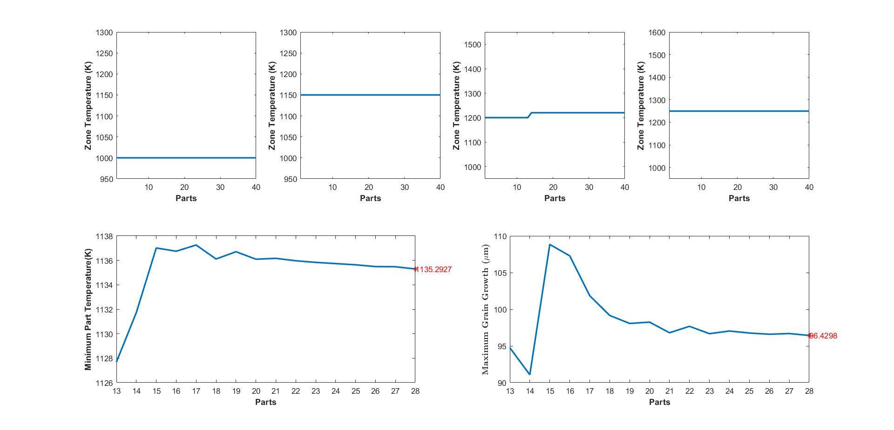
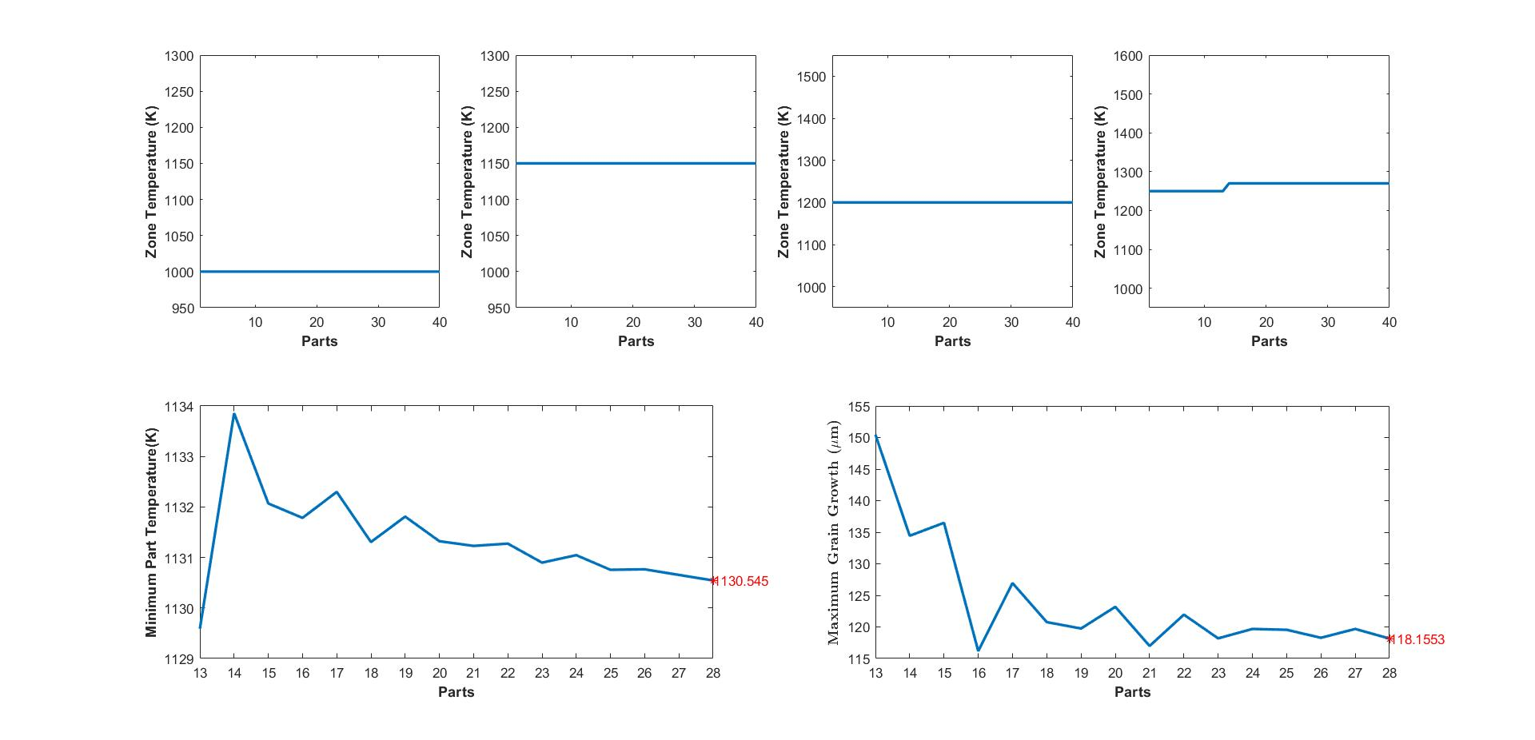
Step response Analysis
Given a step change of 20K in Zone 3 and Zone 4 temperatures.
Zone 3 changes:
Grain Size: 13.43% 3.585%
Min Part Temperature:0.89%
Zone 4 changes:
Grain Size:38.98% 26.923%
Min Part Temperature:0.47%

Slide 27






















Austenitization Furnace
Bilevel MPC.
$$\min{Σ {\left(T_{k}− T_{k}^{R}\right)}^{T} Q_{k}\left(T_{k}− T_{k}^{R}\right)+Σ{\left(u_{k}−u_{k}^{R}\right)}^{T}R_{k}\left(u_{k}−u_{k}^{R}\right)+ ΣΔu_{k}^{T}{R1}_{k}(Δu_{k})}$$
$$T_{sp,3}$$
$$\min{Σ {\left(d_{γ,k}− d_{γ,k}^{R}\right)}^{T} Q_{k}\left(d_{γ,k}− d_{γ,k}^{R}\right)+Σ{\left(u_{k}−u_{k}^{R}\right)}^{T}R_{k}\left(u_{k}−u_{k}^{R}\right)+ ΣΔu_{k}^{T}{R1}_{k}(Δu_{,k})}$$
$$T_{sp,4}$$
$$subject to$$
$$T_{sp,lb}≤T_{sp,l}≤T_{sp,ub}, l ε [1,4]$$
$$T_{sp,ub}=1300K$$
$$T_{sp,l}+T_{sp,diff}≤T_{sp,l+1}, l ε [1,3]$$
$$T_{sp,lb}=1000K$$
$$T_{part,min,lb}≤T_{part,min}$$
Minimum Part Temperature at exit.
$$T_{sp,diff }=30K$$
$$T_{part,min,lb}=1100K$$
$$T_{austenite}=1065K$$
$$\frac{σ_{part,T}}{μ_{part,T}}$$
$$≤ {COV}_{part,ub}$$
$${COV}_{part,ub}=0.05$$
$$d_{γ,max}≤d_{γ,ub}$$
Maximum Grain Growth at exit.
$$d_{γ,ub}=50 μm$$
Important Definitions:
Temperature set points of each individual zone
Lower and upper bounds of the zone temperature set points
The enforced temperature difference between consecutive zones
Standard deviation in temperature
Average temperature
Upper bound on the coefficient of variation
$$T_{sp,l}$$
$${{(T}_{sp,lb},T}_{sp,ub, })$$
$$T_{diff }$$
$$σ_{part,T}$$
$$μ_{part,T}$$
$${COV}_{part,ub}$$

Slide 28
Conclusion
A better understanding of solving Hierarchical MPC Control structures
Extending the BMPC algorithm to more complex system (Austenitization Furnace).
Started with a simple system
Strengthening the understanding of bilevel and multilevel decision-making problems.
Working on understanding the system better.
Exploring the natural hierarchy that may exist between the temperature distribution of the part and its grain size.

Slide 29
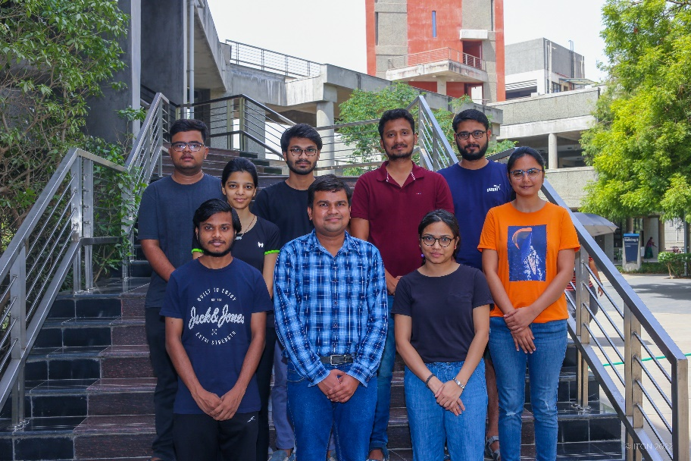
Acknowledgement
I am thankful to the Post-doc in our research group Dr. Radhe Saini for his guidance during my course project.
I am also thankful to Prof. Hari Ganesh research group
members for their support.
Thank You!

Slide 30
Content
Hierarchical order in process industry
Bilevel Programming Problem (BLPP)
Parametric Programming
Multiparametric Programming
Dual Heater Modeling of TCLab.
Bilevel Model Predictive Control
Model Predictive Control (MPC) formulation
Data-Driven State Space equations
Closed Simulation results
Conclusions and Future Work
Acknowledgement

Slide 31

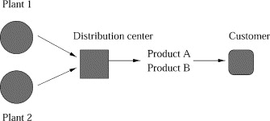





Bilevel Programming Problem (BLPP)
Bilevel Optimization Model
Leader’s problem or
High level decision problem
Follower’s problem or
Low level decision problem
Aim is to minimise both Production cost and distribution cost.
Process configuration of an enterprise
First level (production model) is constrained by another optimization problem (second level,the distribution model).
Reference: Ryu JH, Dua V, Pistikopoulos EN. 2004 Jun 15

Slide 32
Bilevel Model Predictive Control (BMPC)
Solving MPC in hierarchical manner
Controller 1 (Optimisation Problem 1)
Controller 2 (Optimisation Problem 2)
System
Application of Bilevel
Hierarchical model Predictive Control (MPC) structure
Use of a multi-parametric bi-level algorithm
for the development of
Explicit Hierarchical Controllers.
Avraamidou S, Pistikopoulos EN.In Computer aided chemical engineering 2017 Jan 1.Elsevier.
32

Slide 33
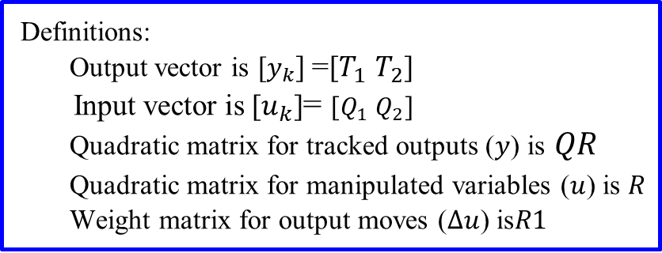
Model Predictive Control (MPC) Formulation
State space equations
MPC formulation is first reformulated into quadratic form using ss2qp_yalmip.
At each sampling instant the quadratic problem is solved using cplexqp solver.
quadprog can also be used but cplexqp gives more stable results.

Slide 34
Data Driven State Space Equations
State space equations were obtained from
MATLAB System Identification Toolbox
The state space equations used as linear constraints in MPC formulation were to be obtained first.
The differential equations representing the physical system are first linearised using MATLAB System Identification ToolBox.
Step Response Analysis method was employed on TCLab, a two heater and two sensor device (MIMO system) .

Slide 35
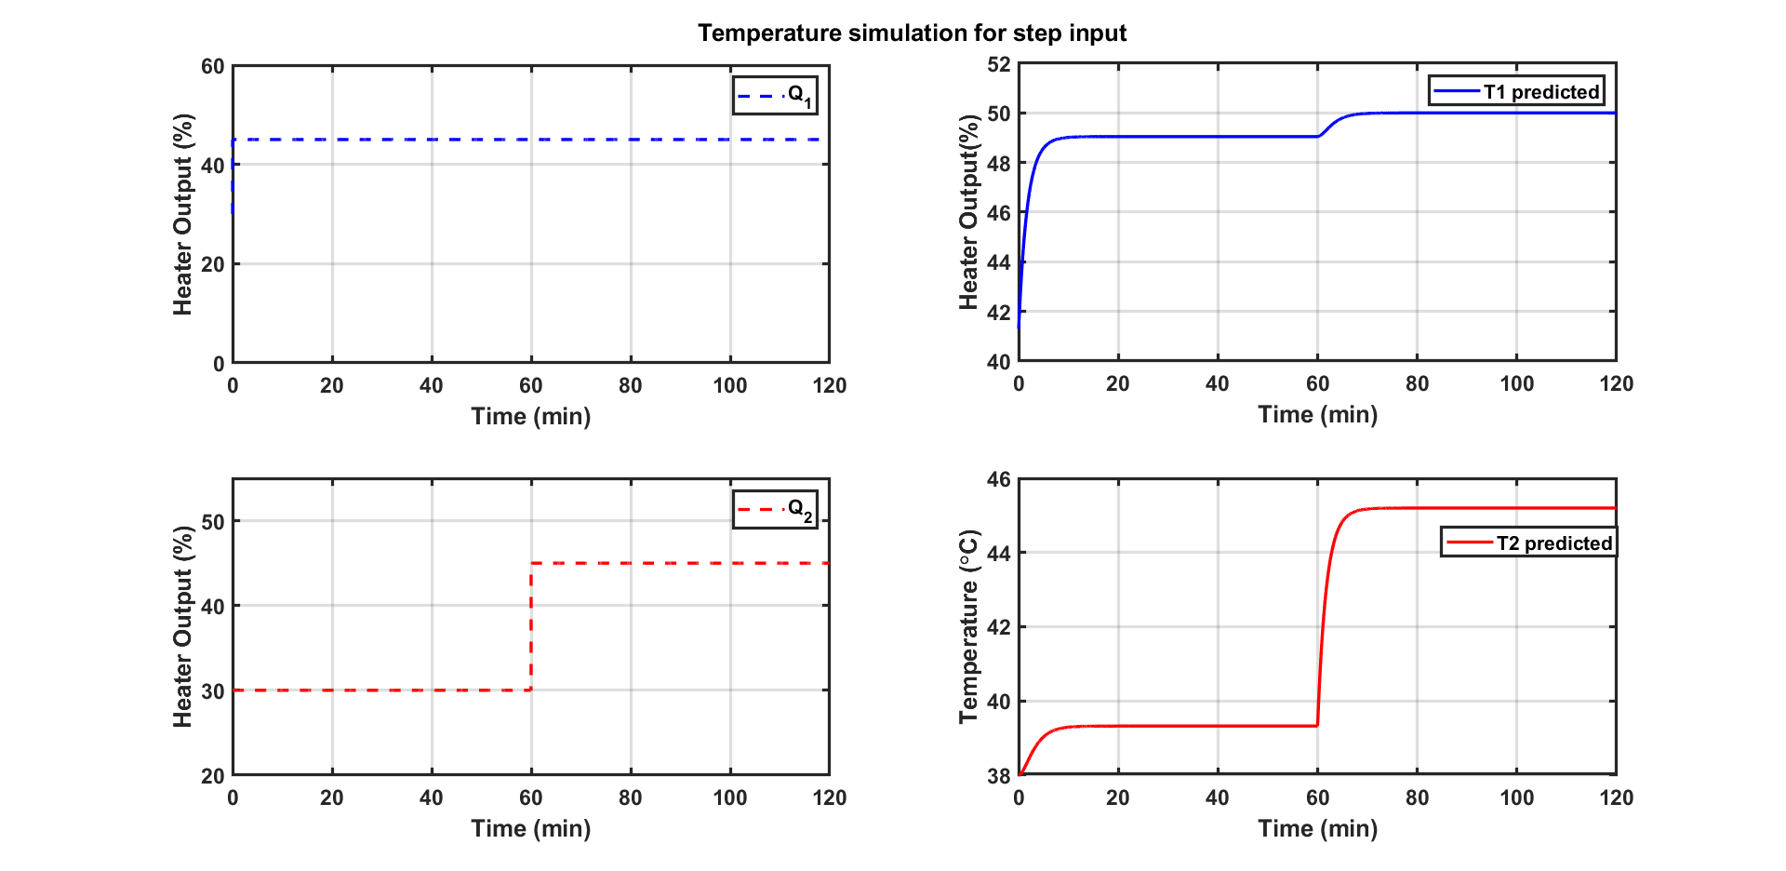
Data Driven State Space Equations
Dual Heater Modeling of TCLab (MIMO System)
Temperature simulation for step changes in Q1 and Q2
The above step response was used to develop data-driven state-space equations using System Identification Toolbox.
The resulting pseudo states equations obtained in matrix form were used as linear constraints in MPC formulation.

Slide 36
Austenitization Furnace
Introduction
Researchers Ganesh et.al have addressed some of the problems that can occur during the austenitization process.
They aim to achieve two main objectives:
To ensure that the final product has the desired quality(target product toughness).
To minimize energy consumption during the austenitization process.
What is an Austenitization Process?
Heat treatment process used in the manufacturing of steel.
Involves heating steel to a high temperature above 900°C. (requires a significant amount of energy).
The microstructure of the steel changes from its original state into austenite.
Rapid cooling after heating leads to desired microstructure and mechanical properties in the final product.
Reference: Ryu JH, Dua V, Pistikopoulos EN. 2004 Jun 15;28(6-7):1121-9.
Reference: Avraamidou, S., & Pistikopoulos, E. N. (2018, June). IEEE.

Slide 37
Austenitization Furnace
Introduction.
Schematic of the 2D Model of Austenitization Furnace (Ganesh et al. (2019))
To produce a sound product, controlling both macroscopic factors (temperature) and microscopic factors (austenite grain size) is essential.
Part temperature and grain size distribution diagram (Ganesh et al. (2019))
Ganesh, H. S., Edgar, T. F., & Baldea, M. (2019).

Slide 38
Austenitization Furnace
Introduction
Heng et al. (2017) addressed problems that can occur in a heat-treating furnace.
Ganesh et al. (2019) addressed problems that can occur during the austenitization process.
They aim to achieve two main objectives:
To ensure that the final product has the desired quality (target product toughness).
To minimize energy consumption during the austenitization process.
Two mathematical models developed by them:
Furnace model
Empirical austenite grain growth prediction model
What is an Austenitization Process?
A critical process in the manufacturing of steel.
Heating steel to a high temperature above 900°C.
Microstructure gets transformed into austenite.
Followed by rapid cooling after heating.
Improper austenitization can lower the steel's mechanical properties and reduce product quality.
To determine the temperature profile of the parts in the furnace over time and position.
Predicting the average size of austenite grains which is influenced by the furnace's temperature profile.
Crucial in determining the toughness of the quenched product.
Reference: Heng, Vincent R., et al. "Energy-oriented modeling and optimization of a heat treating furnace."

